Slide 1
Web Search and Mining
Lecture 15: Classification

Slide 2
Relevance feedback revisited
Classification Problem
In relevance feedback, the user marks a few documents as relevant/nonrelevant
The choices can be viewed as classes or categories
For several documents, the user decides which of these two classes is correct
The IR system then uses these judgments to build a better model of the information need
So, relevance feedback can be viewed as a form of text classification (deciding between several classes)
The notion of classification is very general and has many applications within and beyond IR

Slide 3
Spam filtering: Another text classification task
Classification Problem
From: "" <takworlld@hotmail.com>
Subject: real estate is the only way... gem oalvgkay
Anyone can buy real estate with no money down
Stop paying rent TODAY !
There is no need to spend hundreds or even thousands for similar courses
I am 22 years old and I have already purchased 6 properties using the
methods outlined in this truly INCREDIBLE ebook.
Change your life NOW !
=================================================
Click Below to order:
http://www.wholesaledaily.com/sales/nmd.htm
=================================================

Slide 4
Text classification
Classification Problem
Introduction to text classification
    Also widely known as “text categorization”. Same thing.
Machine learning based text classification methods
  Naïve Bayes
    Including a little on Probabilistic Language Models
  Rocchio method
  kNN
  Support vector machine (SVM)

Slide 5
Supervised Classification
Classification Problem
Given:
  A description of an instance, d ∈ X
    X is the instance language or instance space.
  A fixed set of classes:
  C = {c₁, c₂,…, c_{J}}
  A training set D of labeled documents with each labeled document ⟨d,c⟩∈X×C
Determine:
  A learning method or algorithm which will enable us to learn a classifier γ:X→C
  For a test document d, we assign it the class γ(d) ∈ C

Slide 6
Document Classification
Classification Problem
“planning
language
proof
intelligence”
Test
Data:
(AI)
(Programming)
(HCI)
Classes:
ML
Planning
Semantics
Garb.Coll.
Multimedia
GUI
Training
Data:
learning
intelligence
algorithm
reinforcement
network...
planning
temporal
reasoning
plan
language...
programming
semantics
language
proof...
garbage
collection
memory
optimization
region...
...
...
(Note: in real life there is often a hierarchy, not present in the above problem statement; and also, you get papers on ML approaches to Garb. Coll.)

Slide 7
More Text Classification Examples
Many search engine functionalities use classification
Classification Problem
Assigning labels to documents or web-pages:
Labels are most often topics such as Yahoo-categories
  "finance," "sports," "news>world>asia>business"
Labels may be genres
  "editorials" "movie-reviews" "news”
Labels may be opinion on a person/product
  “like”, “hate”, “neutral”
Labels may be domain-specific
  "interesting-to-me" : "not-interesting-to-me”
  “contains adult language” : “doesn’t”
  language identification: English, French, Chinese, …
  search vertical: about Linux versus not
  “link spam” : “not link spam”

Slide 8
Naïve Bayes methods

Slide 9
Probabilistic relevance feedback
Naïve Bayes
Rather than reweighting in a vector space…
If user has told us some relevant and some irrelevant documents, then we can proceed to build a probabilistic classifier,
    such as the Naive Bayes model we will look at today:
  P(t_{k}|R) = |D_{rk}| / |D_{r}|
  P(t_{k}|NR) = |D_{nrk}| / |D_{nr}|
    t_{k} is a term; D_{r} is the set of known relevant documents; D_{rk} is the subset that contain t_{k}; D_{nr} is the set of known irrelevant documents; D_{nrk} is the subset that contain t_{k}.

Slide 10
Bayesian Methods
Naïve Bayes
Learning and classification methods based on probability theory.
Bayes theorem plays a critical role in probabilistic learning and classification.
Builds a generative model that approximates how data is produced
Uses prior probability of each category given no information about an item.
Categorization produces a posterior probability distribution over the possible categories given a description of an item.

Slide 11
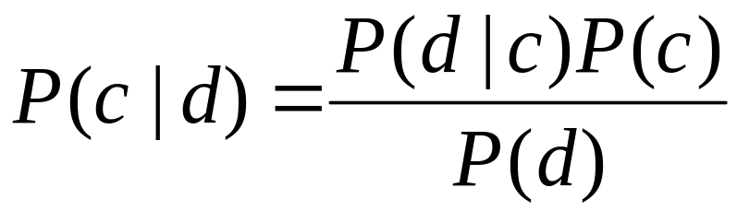
Bayes’ Rule for text classification
Naïve Bayes
For a document d and a class c

Slide 12
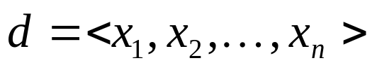
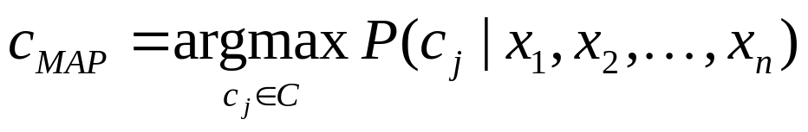
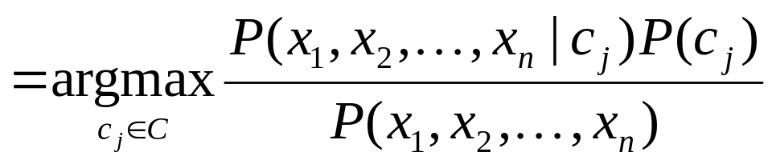
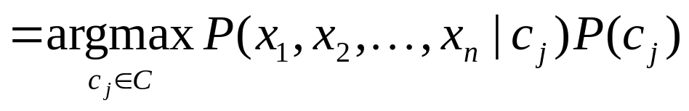
Naive Bayes Classifiers
Naïve Bayes
Task: Classify a new instance d based on a tuple of attribute values into one of the classes c_{j} ∈ C
MAP is “maximum a posteriori” = most likely class

Slide 13
Naïve Bayes Classifier:
Naïve Bayes Assumption
Naïve Bayes
P(c_{j})
  Can be estimated from the frequency of classes in the training examples.
P(x₁,x₂,…,x_{n}|c_{j})
  O(|X|^{n}•|C|) parameters
  Could only be estimated if a very, very large number of training examples was available.
Naïve Bayes Conditional Independence Assumption:
Assume that the probability of observing the conjunction of attributes is equal to the product of the individual probabilities P(x_{i}|c_{j}).

Slide 14
The Naïve Bayes Classifier
Naïve Bayes
Flu
X₁
X₂
X₃
X₄
X₅
runnynose
sinus
cough
fever
muscle-ache
Conditional Independence Assumption: features detect term presence and are independent of each other given the class:

Slide 15
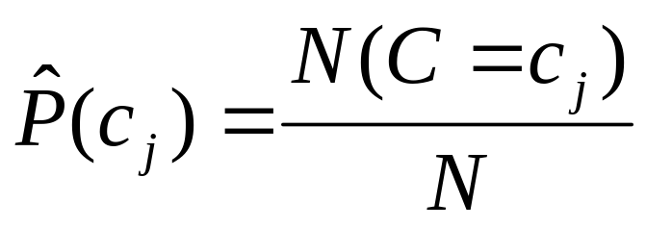
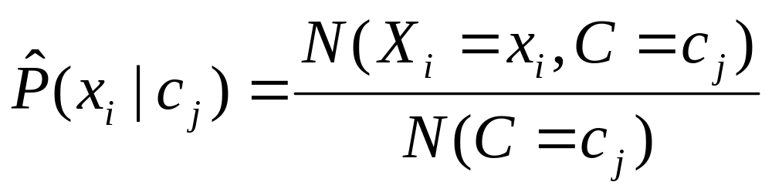
Learning the Model
Naïve Bayes
C
X₁
X₂
X₃
X₄
X₅
X₆
First attempt: maximum likelihood estimates
  simply use the frequencies in the data

Slide 16
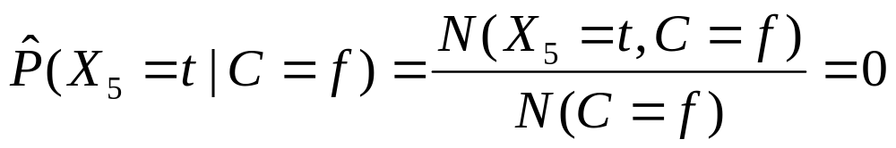
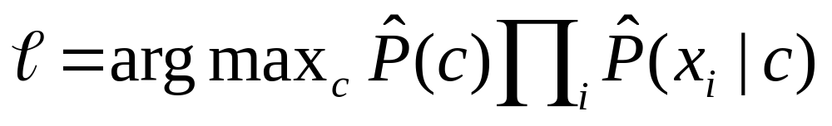
Problem with Maximum Likelihood
Naïve Bayes
Flu
X₁
X₂
X₃
X₄
X₅
runnynose
sinus
cough
fever
muscle-ache
What if we have seen no training documents with the word muscle-ache and classified in the topic Flu?
Zero probabilities cannot be conditioned away, no matter the other evidence!
Multivariate Bernoulli Model

Slide 17
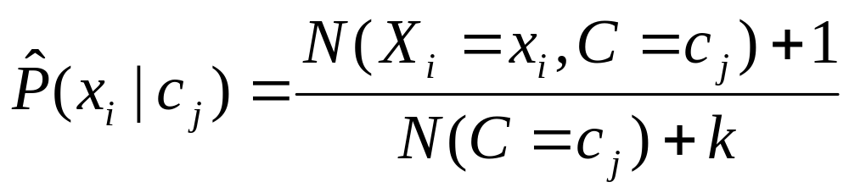
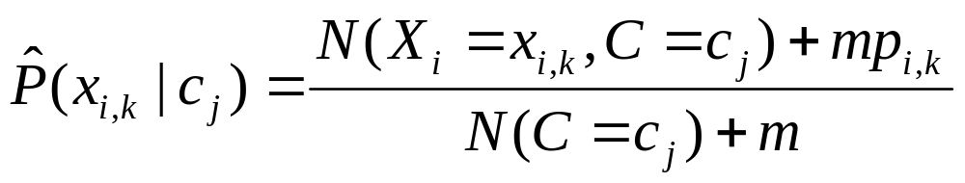
Smoothing to Avoid Overfitting
Naïve Bayes
# of values of X_{i}
overall fraction in data where X_{i}=x_{i,k}
Somewhat more subtle version
extent of
“smoothing”
Notes:
Note that this was discussed in the review section, for giving better estimates in the spelling correction exercise.

Slide 18
Naïve Bayes via a class conditional language model = multinomial NB
Naïve Bayes
C
w₁
w₂
w₃
w₄
w₅
w₆
Effectively, the probability of each class is done as a class-specific unigram language model

Slide 19
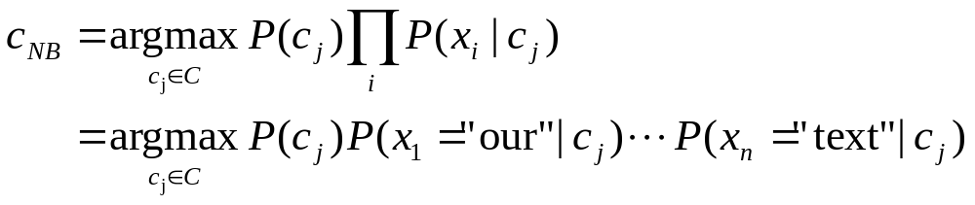
Using Multinomial Naive Bayes Classifiers to Classify Text: Basic method
Naïve Bayes
Attributes are text positions, values are words.
Still too many possibilities
Assume that classification is independent of the positions of the words
  Use same parameters for each position
  Result is bag-of-words model (over tokens not types)

Slide 20
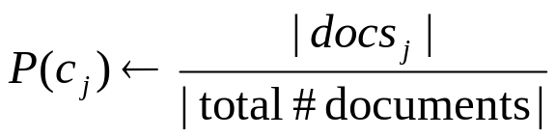
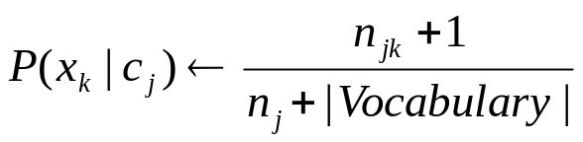
Naive Bayes: Learning
Running example: document classification
Naïve Bayes
From training corpus, extract Vocabulary
Calculate required P(c_{j}) and P(x_{k} | c_{j}) terms
  For each c_{j} in C do
    docs_{j} ← subset of documents for which the target class is c_{j}
    Text_{j} ← single document containing all docs_{j}
    for each word x_{k} in Vocabulary
      n_{jk} ← number of occurrences of x_{k} in Text_{j}
      n_{j}← number of words in Text_{j}

Slide 21
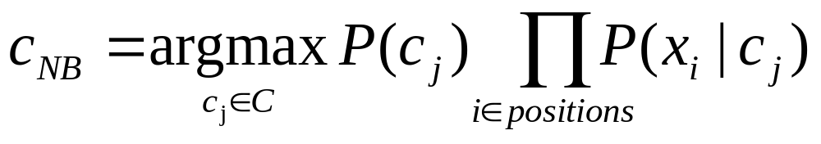
Naive Bayes: Classifying
Naïve Bayes
positions ← all word positions in current document which contain tokens found in Vocabulary
Return c_{NB}, where

Slide 22
Naive Bayes: Time Complexity
Naïve Bayes
Training Time: O(|D|L_{ave} + |C||V|)) where L_{ave} is the average length of a document in D.
  Assumes all counts are pre-computed in O(|D|L_{ave}) time during one pass through all of the data.
  Generally just O(|D|L_{ave}) since usually |C||V| < |D|L_{ave}
Test Time: O(|C| L_{t}) where L_{t} is the average length of a test document.
Very efficient overall, linearly proportional to the time needed to just read in all the data.
Why?

Slide 23
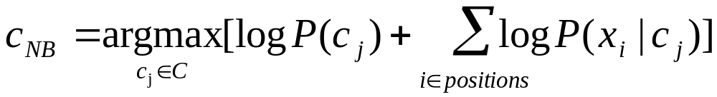
Underflow Prevention: using logs
Naïve Bayes
Multiplying lots of probabilities, which are between 0 and 1 by definition, can result in floating-point underflow.
Since log(xy) = log(x) + log(y), it is better to perform all computations by summing logs of probabilities rather than multiplying probabilities.
Class with highest final un-normalized log probability score is still the most probable.
Note that model is now just max of sum of weights…

Slide 24
Naive Bayes Classifier
Naïve Bayes
Simple interpretation: Each conditional parameter log P(x_{i}|c_{j}) is a weight that indicates how good an indicator x_{i} is for c_{j}.
The prior log P(c_{j}) is a weight that indicates the relative frequency of c_{j}.
The sum is then a measure of how much evidence there is for the document being in the class.
We select the class with the most evidence for it

Slide 25
Two Naive Bayes Models
Naïve Bayes
Model 1: Multivariate Bernoulli
  One feature X_{w} for each word in dictionary
  X_{w} = true in document d if w appears in d
  Naive Bayes assumption:
    Given the document’s topic, appearance of one word in the document tells us nothing about chances that another word appears
This is the model used in the binary independence model in classic probabilistic relevance feedback on hand-classified data (Maron in IR was a very early user of NB)

Slide 26
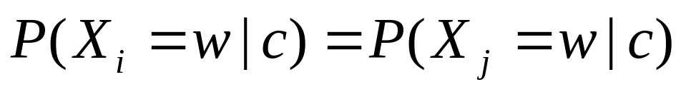
Two Models
Naïve Bayes
Model 2: Multinomial = Class conditional unigram
  One feature X_{i} for each word position in document
    feature’s values are all words in dictionary
  Value of X_{i} is the word in position i
  Naïve Bayes assumption:
    Given the document’s topic, word in one position in the document tells us nothing about words in other positions
  Second assumption:
    Word appearance does not depend on position
    Just have one multinomial feature predicting all words
for all positions i,j, word w, and class c

Slide 27
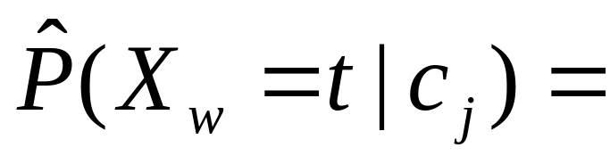
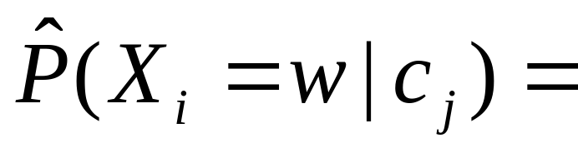
Parameter estimation
Naïve Bayes
Multivariate Bernoulli model:
Multinomial model:
  Can create a mega-document for topic j by concatenating all documents in this topic
  Use frequency of w in mega-document
fraction of documents of topic c_{j}
in which word w appears
fraction of times in which
word w appears among all
words in documents of topic c_{j}

Slide 28
Classification
Naïve Bayes
Multinomial vs Multivariate Bernoulli?
Multinomial model is almost always more effective in text applications!
    See results figures later
See IIR sections 13.2 and 13.3 for worked examples with each model

Slide 29
The rest of text classification methods
Vector space methods for Text Classification
  Vector space classification using centroids (Rocchio)
  K Nearest Neighbors
  Support Vector Machines

Slide 30
Recall: Vector Space Representation
Vector Space Representation
Each document is a vector, one component for each term (= word).
Normally normalize vectors to unit length.
High-dimensional vector space:
  Terms are axes
  10,000+ dimensions, or even 100,000+
  Docs are vectors in this space
How can we do classification in this space?

Slide 31
Classification Using Vector Spaces
Vector Space Representation
As before, the training set is a set of documents, each labeled with its class (e.g., topic)
In vector space classification, this set corresponds to a labeled set of points (or, equivalently, vectors) in the vector space
Premise 1: Documents in the same class form a contiguous region of space
Premise 2: Documents from different classes don’t overlap (much)
We define surfaces to delineate classes in the space

Slide 32
Documents in a Vector Space
Vector Space Representation
Government
Science
Arts

Slide 33
Test Document of what class?
Vector Space Representation
Government
Science
Arts

Slide 34
Test Document = Government
Vector Space Representation
Is this
similarity
hypothesis
true in
general?
Government
Science
Arts
Our main topic today is how to find good separators

Slide 35
Rocchio Classification

Slide 36
Using Rocchio for text classification
Rocchio Classification
Relevance feedback methods can be adapted for text categorization
  As noted before, relevance feedback can be viewed as 2-class classification
    Relevant vs. nonrelevant documents
Use standard tf-idf weighted vectors to represent text documents
For training documents in each category, compute a prototype vector by summing the vectors of the training documents in the category.
  Prototype = centroid of members of class
Assign test documents to the category with the closest prototype vector based on cosine similarity.

Slide 37
Illustration of Rocchio Text Categorization
Rocchio Classification

Slide 38
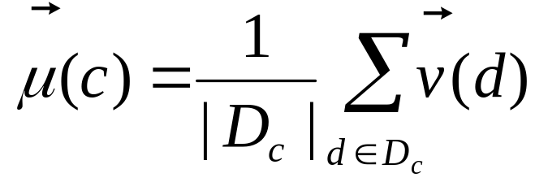
Definition of centroid
Rocchio Classification
Where D_{c} is the set of all documents that belong to class c and v(d) is the vector space representation of d.
Note that centroid will in general not be a unit vector even when the inputs are unit vectors.

Slide 39
Rocchio Properties
Rocchio Classification
Forms a simple generalization of the examples in each class (a prototype).
Prototype vector does not need to be averaged or otherwise normalized for length since cosine similarity is insensitive to vector length.
Classification is based on similarity to class prototypes.
Does not guarantee classifications are consistent with the given training data.
Why not?

Slide 40
Rocchio Anomaly
Rocchio Classification
Prototype models have problems with polymorphic (disjunctive) categories.

Slide 41
Rocchio classification
Rocchio Classification
Rocchio forms a simple representation for each class: the centroid/prototype
Classification is based on similarity to / distance from the prototype/centroid
It does not guarantee that classifications are consistent with the given training data
It is little used outside text classification
  It has been used quite effectively for text classification
  But in general worse than Naïve Bayes
Again, cheap to train and test documents

Slide 42
kNN Classification

Slide 43
k Nearest Neighbor Classification
K Nearest Neighbor
kNN = k Nearest Neighbor
To classify a document d into class c:
Define k-neighborhood N as k nearest neighbors of d
Count number of documents ic in N that belong to c
Estimate P(c|d) as ic/k
Choose as class argmax_{c} P(c|d) [ = majority class]

Slide 44
Example: k=6 (6NN)
K Nearest Neighbor
P(science| )?
Government
Science
Arts

Slide 45
Nearest-Neighbor Learning Algorithm
K Nearest Neighbor
Learning is just storing the representations of the training examples in D.
Testing instance x (under 1NN):
  Compute similarity between x and all examples in D.
  Assign x the category of the most similar example in D.
Does not explicitly compute a generalization or category prototypes.
Also called:
  Case-based learning
  Memory-based learning
  Lazy learning
Rationale of kNN: contiguity hypothesis

Slide 46
kNN Is Close to Optimal
K Nearest Neighbor
Cover and Hart (1967)
Asymptotically, the error rate of 1-nearest-neighbor classification is less than twice the Bayes rate [error rate of classifier knowing model that generated data]
In particular, asymptotic error rate is 0 if Bayes rate is 0.
Assume: query point coincides with a training point.
Both query point and training point contribute error → 2 times Bayes rate

Slide 47
k Nearest Neighbor
K Nearest Neighbor
Using only the closest example (1NN) to determine the class is subject to errors due to:
  A single atypical example.
  Noise (i.e., an error) in the category label of a single training example.
More robust alternative is to find the k most-similar examples and return the majority category of these k examples.
Value of k is typically odd to avoid ties; 3 and 5 are most common.

Slide 48
kNN decision boundaries
K Nearest Neighbor
Boundaries are in principle arbitrary surfaces – but usually polyhedra
Government
Science
Arts
kNN gives locally defined decision boundaries between
classes – far away points do not influence each classification
decision (unlike in Naïve Bayes, Rocchio, etc.)

Slide 49
Similarity Metrics
K Nearest Neighbor
Nearest neighbor method depends on a similarity (or distance) metric.
Simplest for continuous m-dimensional instance space is Euclidean distance.
Simplest for m-dimensional binary instance space is Hamming distance (number of feature values that differ).
For text, cosine similarity of tf.idf weighted vectors is typically most effective.

Slide 50
Illustration of 3 Nearest Neighbor for Text Vector Space
K Nearest Neighbor

Slide 51
3 Nearest Neighbor vs. Rocchio
K Nearest Neighbor
Nearest Neighbor tends to handle polymorphic categories better than Rocchio/NB.

Slide 52
Nearest Neighbor with Inverted Index
K Nearest Neighbor
Naively finding nearest neighbors requires a linear search through |D| documents in collection
But determining k nearest neighbors is the same as determining the k best retrievals using the test document as a query to a database of training documents.
Use standard vector space inverted index methods to find the k nearest neighbors.
Testing Time: O(B|V_{t}|) where B is the average number of training documents in which a test-document word appears.
  Typically B << |D|

Slide 53
kNN: Discussion
K Nearest Neighbor
Scales well with large number of classes
  Don’t need to train n classifiers for n classes
Classes can influence each other
  Small changes to one class can have ripple effect
Scores can be hard to convert to probabilities
No training necessary
  Actually: perhaps not true. (Data editing, etc.)
May be expensive at test time
In most cases it’s more accurate than NB or Rocchio

Slide 54
Support Vector Machine

Slide 55
Linear classifiers and binary and multiclass classification
Consider 2 class problems
  Deciding between two classes, perhaps, government and non-government
    One-versus-rest classification
How do we define (and find) the separating surface?
How do we decide which region a test doc is in?

Slide 56
Linear classifier: Example
Linear Vs Nonlinear
Class: “interest” (as in interest rate)
Example features of a linear classifier
w_{i} t_{i} w_{i} t_{i}
To classify, find dot product of feature vector and weights
0.70 prime
0.67 rate
0.63 interest
0.60 rates
0.46 discount
0.43 bundesbank
−0.71 dlrs
−0.35 world
−0.33 sees
−0.25 year
−0.24 group
−0.24 dlr

Slide 57
Linear Classifiers
Linear Vs Nonlinear
Many common text classifiers are linear classifiers
  Naïve Bayes
  Perceptron
  Rocchio
  Logistic regression
  Support vector machines (with linear kernel)
  Linear regression with threshold
Despite this similarity, noticeable performance differences
  For separable problems, there is an infinite number of separating hyperplanes. Which one do you choose?
  What to do for non-separable problems?
  Different training methods pick different hyperplanes
Classifiers more powerful than linear often don’t perform better on text problems. Why?

Slide 58
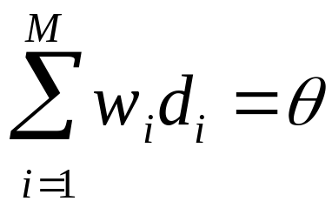
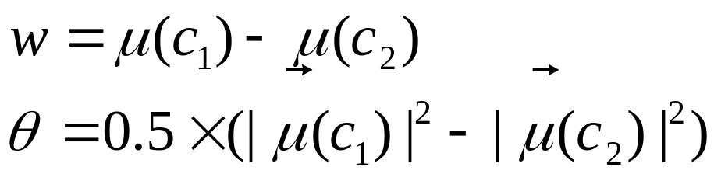
Two-class Rocchio as a linear classifier
Linear Vs Nonlinear
Line or hyperplane defined by:
For Rocchio, set:
[Aside for ML/stats people: Rocchio classification is a simplification of the classic Fisher Linear Discriminant where you don’t model the variance (or assume it is spherical).]

Slide 59
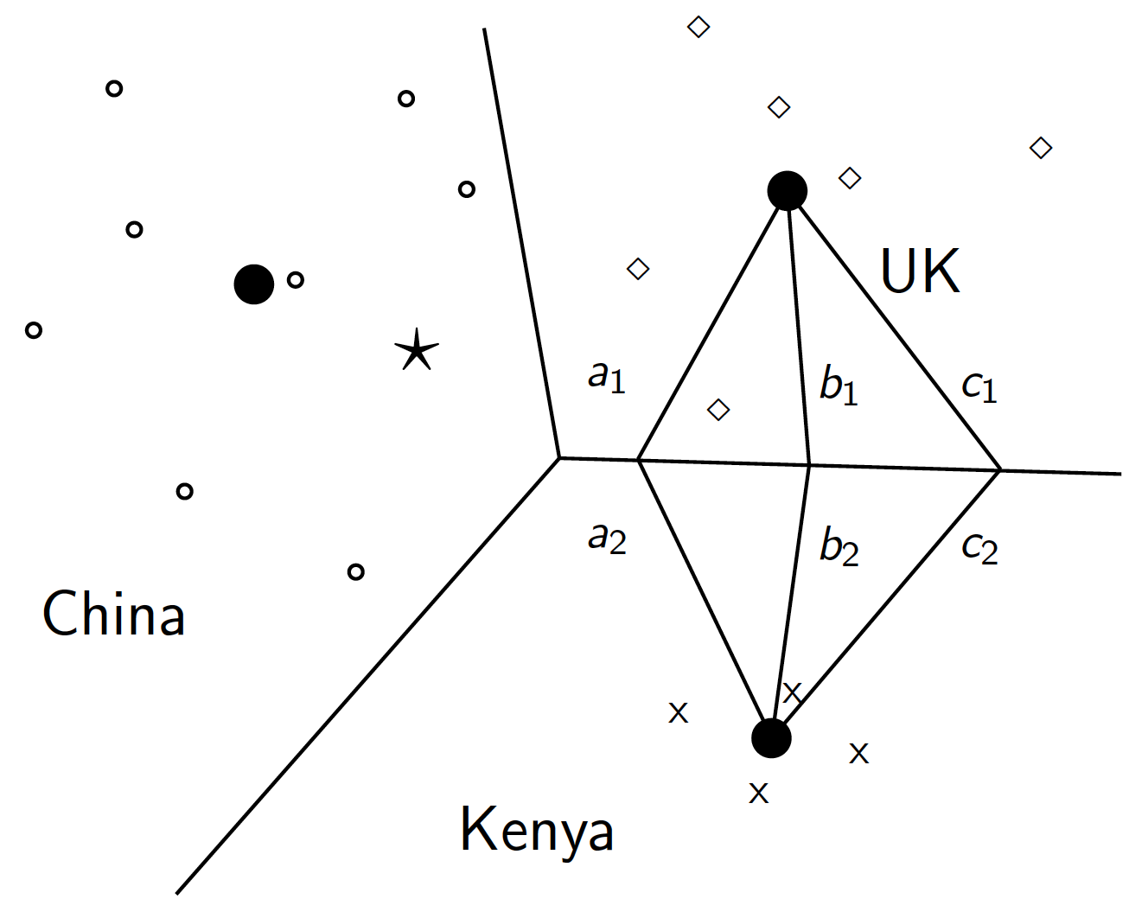
Rocchio is a linear classifier
Linear Vs Nonlinear

Slide 60
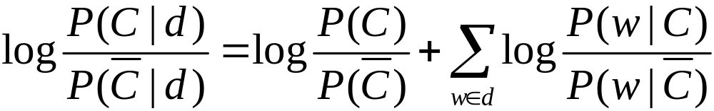
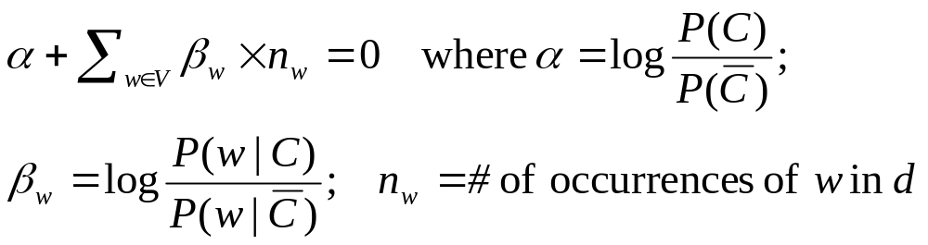
Naive Bayes is a linear classifier
Linear Vs Nonlinear
Two-class Naive Bayes. We compute:
Decide class C if the odds is greater than 1, i.e., if the log odds is greater than 0.
So decision boundary is hyperplane:

Slide 61
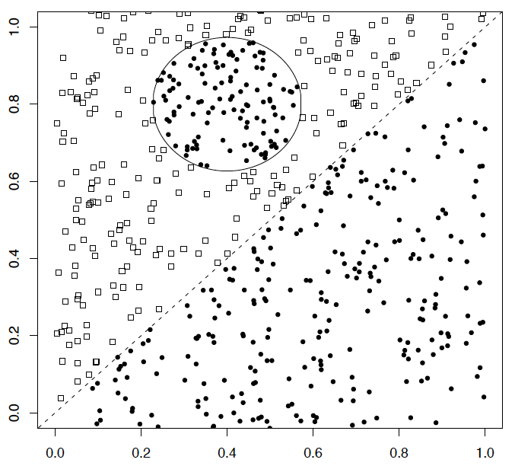
A nonlinear problem
Linear Vs Nonlinear
A linear classifier like Naïve Bayes does badly on this task
kNN will do very well (assuming enough training data)

Slide 62
Separation by Hyperplanes
Linear Vs Nonlinear
A strong high-bias assumption is linear separability:
  in 2 dimensions, can separate classes by a line
  in higher dimensions, need hyperplanes
Can find separating hyperplane by linear programming
  (or can iteratively fit solution via perceptron):
  separator can be expressed as ax + by = c

Slide 63
Linear programming / Perceptron
Linear Vs Nonlinear
Find a,b,c, such that
ax + by > c for red points
ax + by < c for blue points.

Slide 64
Which Hyperplane?
Linear Vs Nonlinear
In general, lots of possible
solutions for a,b,c.

Slide 65
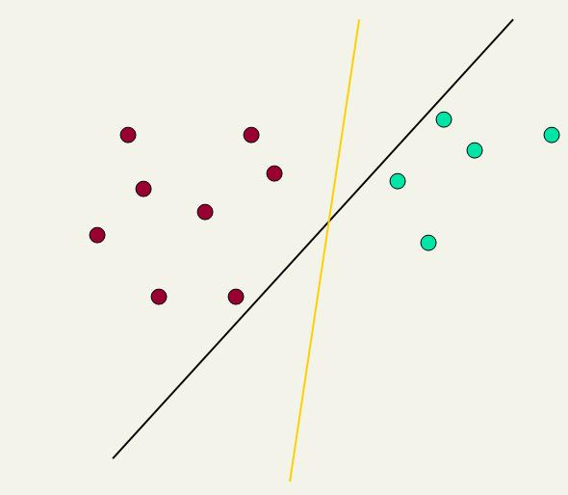
Which Hyperplane?
Linear Vs Nonlinear
Lots of possible solutions for a,b,c.
Some methods find a separating hyperplane, but not the optimal one [according to some criterion of expected goodness]
  E.g., perceptron
Most methods find an optimal separating hyperplane
Which points should influence optimality?
  All points
    Linear/logistic regression
    Naïve Bayes
  Only “difficult points” close to decision boundary
    Support vector machines

Slide 66
Linear classifiers: Which Hyperplane?
Support Vector Machine
Lots of possible solutions for a, b, c.
Some methods find a separating hyperplane, but not the optimal one [according to some criterion of expected goodness]
  E.g., perceptron
Support Vector Machine (SVM) finds an optimal solution.
  Maximizes the distance between the hyperplane and the “difficult points” close to decision boundary
  One intuition: if there are no points near the decision surface, then there are no very uncertain classification decisions
This line represents the decision boundary:
ax + by − c = 0
Notes:
But note that Naïve Bayes also finds an optimal solution … just under a different definition of optimality.

Slide 67
Support Vector Machine (SVM)
Support Vector Machine
SVMs maximize the margin around the separating hyperplane.
    A.k.a. large margin classifiers
The decision function is fully specified by a subset of training samples, the support vectors.
Solving SVMs is a quadratic programming problem
Seen by many as the most successful current text classification method*
Support vectors
Maximizes
margin
Narrower
margin
*but other discriminative methods often perform very similarly

Slide 68
Maximum Margin: Formalization
Support Vector Machine
w: decision hyperplane normal vector
x_{i}: data point i
y_{i}: class of data point i (+1 or -1) NB: Not 1/0
Classifier is: f(x_{i}) = sign(w^{T}x_{i} + b)
Functional margin of x_{i} is: y_{i} (w^{T}x_{i} + b)
  But note that we can increase this margin simply by scaling w, b….

Slide 69
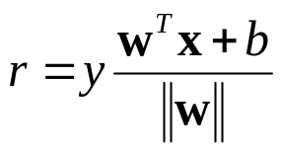
Geometric Margin
Support Vector Machine
Distance from example to the separator is
Examples closest to the hyperplane are support vectors.
Margin ρ of the separator is the width of separation between support vectors of classes.
x
ρ
Derivation of finding r:
Dotted line x’−x is perpendicular to
decision boundary so parallel to w.
Unit vector is w/||w||, so line is rw/||w||.
x’ = x – yrw/||w||.
x’ satisfies w^{T}x’+b = 0.
So w^{T}(x –yrw/||w||) + b = 0
Recall that ||w|| = sqrt(w^{T}w).
So, solving for r gives:
r = y(w^{T}x + b)/||w||
r
x’
w
Notes:
Looking for distance r. Dotted line x’-x is perpendicular to decision boundary so parallel to w. Unit vector is w/|w|, so this one is rw/|w|.
x’ = x – rw/|w|. X’ satisfies wx+b = 0.
So wT(x –rw/|w|) + b = 0
Recall that |w| = sqrt(wTw). So, solving for r gives:
r = y(wTx + b)/|w|

Slide 70
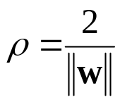
Linear SVM Mathematically
The linearly separable case
Support Vector Machine
Assume that all data is at least distance 1 from the hyperplane, then the following two constraints follow for a training set {(x_{i} ,y_{i})}
For support vectors, the inequality becomes an equality
Then, since each example’s distance from the hyperplane is
The margin is:
w^{T}x_{i} + b ≥ 1 if y_{i} = 1
w^{T}x_{i} + b ≤ -1 if y_{i} = -1

Slide 71
Linear Support Vector Machine (SVM)
Support Vector Machine
ρ
w^{T}x_{a} + b = 1
Hyperplane
w^{T} x + b = 0
Extra scale constraint:
min_{i=1,…,n} |w^{T}x_{i} + b| = 1
This implies:
w^{T}(x_{a}–x_{b}) = 2
ρ = ||x_{a}–x_{b}||₂ = 2/||w||₂
w^{T}x_{b} + b = -1
w^{T} x + b = 0

Slide 72
Linear SVMs Mathematically (cont.)
Support Vector Machine
Then we can formulate the quadratic optimization problem:
A better formulation (min ||w|| = max 1/ ||w|| ):
Find w and b such that
is maximized; and for all {(x_{i} , y_{i})}
w^{T}x_{i} + b ≥ 1 if y_{i}=1; w^{T}x_{i} + b ≤ -1 if y_{i} = -1
Find w and b such that
Φ(w) =½ w^{T}w is minimized;
and for all {(x_{i} ,y_{i})}: y_{i} (w^{T}x_{i} + b) ≥ 1

Slide 73
Solving the Optimization Problem
Support Vector Machine
This is now optimizing a quadratic function subject to linear constraints
Quadratic optimization problems are a well-known class of mathematical programming problem, and many (intricate) algorithms exist for solving them (with many special ones built for SVMs)
The solution involves constructing a dual problem where a Lagrange multiplier α_{i} is associated with every constraint in the primary problem:
Find w and b such that
Φ(w) =½ w^{T}w is minimized;
and for all {(x_{i} ,y_{i})}: y_{i} (w^{T}x_{i} + b) ≥ 1
Find α₁…α_{N} such that
Q(α) =Σα_{i} - ½ΣΣα_{i}α_{j}y_{i}y_{j}x_{i}^{T}x_{j} is maximized and
(1) Σα_{i}y_{i} = 0
(2) α_{i} ≥ 0 for all α_{i}

Slide 74
The Optimization Problem Solution
Support Vector Machine
The solution has the form:
Each non-zero α_{i} indicates that corresponding x_{i} is a support vector.
Then the classifying function will have the form:
Notice that it relies on an inner product between the test point x and the support vectors x_{i} – we will return to this later.
Also keep in mind that solving the optimization problem involved computing the inner products x_{i}^{T}x_{j} between all pairs of training points.
w =Σα_{i}y_{i}x_{i} b= y_{k}- w^{T}x_{k} for any x_{k} such that α_{k}≠ 0
f(x) = Σα_{i}y_{i}x_{i}^{T}x + b

Slide 75
Soft Margin Classification
Support Vector Machine
If the training data is not linearly separable, slack variables ξ_{i} can be added to allow misclassification of difficult or noisy examples.
Allow some errors
  Let some points be moved to where they belong, at a cost
Still, try to minimize training set errors, and to place hyperplane “far” from each class (large margin)
ξ_{i}
ξ_{j}

Slide 76
Soft Margin Classification Mathematically
Support Vector Machine
The old formulation:
The new formulation incorporating slack variables:
Parameter C can be viewed as a way to control overfitting – a regularization term
Find w and b such that
Φ(w) =½ w^{T}w is minimized and for all {(x_{i} ,y_{i})}
y_{i} (w^{T}x_{i} + b) ≥ 1
Find w and b such that
Φ(w) =½ w^{T}w + CΣξ_{i} is minimized and for all {(x_{i} ,y_{i})}
y_{i} (w^{T}x_{i} + b) ≥ 1- ξ_{i} and ξ_{i} ≥ 0 for all i

Slide 77
Soft Margin Classification – Solution
Support Vector Machine
The dual problem for soft margin classification:
Neither slack variables ξ_{i} nor their Lagrange multipliers appear in the dual problem!
Again, x_{i} with non-zero α_{i} will be support vectors.
Solution to the dual problem is:
Find α₁…α_{N} such that
Q(α) =Σα_{i} - ½ΣΣα_{i}α_{j}y_{i}y_{j}x_{i}^{T}x_{j} is maximized and
(1) Σα_{i}y_{i} = 0
(2) 0 ≤ α_{i} ≤ C for all α_{i}
w is not needed explicitly for classification!
w = Σα_{i}y_{i}x_{i}
b = y_{k}(1- ξ_{k}) - w^{T}x_{k} where k = argmax α_{k’}
k’
f(x) = Σα_{i}y_{i}x_{i}^{T}x + b

Slide 78
Classification with SVMs
Support Vector Machine
Given a new point x, we can score its projection onto the hyperplane normal:
  I.e., compute score: w^{T}x + b = Σα_{i}y_{i}x_{i}^{T}x + b
  Can set confidence threshold t.
Score > t: yes
Score < -t: no
Else: don’t know
1
0
-1

Slide 79
Linear SVMs: Summary
Support Vector Machine
The classifier is a separating hyperplane.
The most “important” training points are the support vectors; they define the hyperplane.
Quadratic optimization algorithms can identify which training points x_{i} are support vectors with non-zero Lagrangian multipliers α_{i}.
Both in the dual formulation of the problem and in the solution, training points appear only inside inner products:
Find α₁…α_{N} such that
Q(α) =Σα_{i} - ½ΣΣα_{i}α_{j}y_{i}y_{j}x_{i}^{T}x_{j} is maximized and
(1) Σα_{i}y_{i} = 0
(2) 0 ≤ α_{i} ≤ C for all α_{i}
f(x) = Σα_{i}y_{i}x_{i}^{T}x + b

Slide 80
Non-linear SVMs
Support Vector Machine
Datasets that are linearly separable (with some noise) work out great:
But what are we going to do if the dataset is just too hard?
How about … mapping data to a higher-dimensional space:
0
x
0
x
x²
0
x

Slide 81
Non-linear SVMs: Feature spaces
Support Vector Machine
General idea: the original feature space can always be mapped to some higher-dimensional feature space where the training set is separable:
Φ: x → φ(x)

Slide 82
The “Kernel Trick”
Support Vector Machine
The linear classifier relies on an inner product between vectors K(x_{i},x_{j})=x_{i}^{T}x_{j}
If every data point is mapped into high-dimensional space via some transformation Φ: x → φ(x), the inner product becomes:
K(x_{i},x_{j})= φ(x_{i}) ^{T}φ(x_{j})
A kernel function is some function that corresponds to an inner product in some expanded feature space.
Example:
2-dimensional vectors x=[x₁ x₂]; let K(x_{i},x_{j})=(1 + x_{i}^{T}x_{j})²,
Need to show that K(x_{i},x_{j})= φ(x_{i}) ^{T}φ(x_{j}):
K(x_{i},x_{j})=(1 + x_{i}^{T}x_{j})²,= 1+ x_{i1}²x_{j1}² + 2 x_{i1}x_{j1} x_{i2}x_{j2}+ x_{i2}²x_{j2}² + 2x_{i1}x_{j1} + 2x_{i2}x_{j2}=
= [1 x_{i1}² √2 x_{i1}x_{i2} x_{i2}² √2x_{i1} √2x_{i2}]^{T} [1 x_{j1}² √2 x_{j1}x_{j2} x_{j2}² √2x_{j1} √2x_{j2}]
= φ(x_{i}) ^{T}φ(x_{j}) where φ(x) = [1 x₁² √2 x₁x₂ x₂² √2x₁ √2x₂]

Slide 83

Kernels
Support Vector Machine
Why use kernels?
  Make non-separable problem separable.
  Map data into better representational space
Common kernels
  Linear
  Polynomial K(x,z) = (1+x^{T}z)^{d}
    Gives feature conjunctions
  Radial basis function (infinite dimensional space)
Haven’t been very useful in text classification

Slide 84
Evaluation: Classic Reuters-21578 Data Set
Evaluation
Most (over)used data set
21578 documents
9603 training, 3299 test articles (ModApte/Lewis split)
118 categories
  An article can be in more than one category
  Learn 118 binary category distinctions
Average document: about 90 types, 200 tokens
Average number of classes assigned
  1.24 for docs with at least one category
Only about 10 out of 118 categories are large
Common categories
(#train, #test)
Earn (2877, 1087)
Acquisitions (1650, 179)
Money-fx (538, 179)
Grain (433, 149)
Crude (389, 189)
Trade (369,119)
Interest (347, 131)
Ship (197, 89)
Wheat (212, 71)
Corn (182, 56)

Slide 85
Reuters Text Categorization data set (Reuters-21578) document
Evaluation
<REUTERS TOPICS="YES" LEWISSPLIT="TRAIN" CGISPLIT="TRAINING-SET" OLDID="12981" NEWID="798">
<DATE> 2-MAR-1987 16:51:43.42</DATE>
<TOPICS><D>livestock</D><D>hog</D></TOPICS>
<TITLE>AMERICAN PORK CONGRESS KICKS OFF TOMORROW</TITLE>
<DATELINE> CHICAGO, March 2 - </DATELINE><BODY>The American Pork Congress kicks off tomorrow, March 3, in Indianapolis with 160 of the nations pork producers from 44 member states determining industry positions on a number of issues, according to the National Pork Producers Council, NPPC.
Delegates to the three day Congress will be considering 26 resolutions concerning various issues, including the future direction of farm policy and the tax law as it applies to the agriculture sector. The delegates will also debate whether to endorse concepts of a national PRV (pseudorabies virus) control and eradication program, the NPPC said.
A large trade show, in conjunction with the congress, will feature the latest in technology in all areas of the industry, the NPPC added. Reuter
&#3;</BODY></TEXT></REUTERS>

Slide 86


Good practice department:
Confusion matrix
Evaluation
This (i, j) entry of the confusion matrix means of the points actually in class i were put in class j by the classifier.
Class assigned by classifier
Actual Class
53
In a perfect classification, only the diagonal has non-zero entries

Slide 87
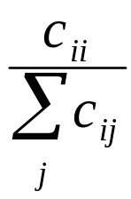
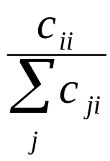
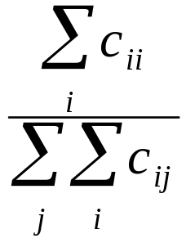
Per class evaluation measures
Evaluation
Recall: Fraction of docs in class i classified correctly:
Precision: Fraction of docs assigned class i that are actually about class i:
Accuracy: (1 - error rate) Fraction of docs classified correctly:

Slide 88
Micro- vs. Macro-Averaging
Evaluation
If we have more than one class, how do we combine multiple performance measures into one quantity?
Macroaveraging: Compute performance for each class, then average.
Microaveraging: Collect decisions for all classes, compute contingency table, evaluate.

Slide 89
Micro- vs. Macro-Averaging: Example
Evaluation
Confusion matrices:
Class 1
Class 2
Micro Ave. Table
 | Classifier: yes | Classifier: no
Truth: yes | 10 | 10
Truth: no | 30 | 970
 | Classifier: yes | Classifier: no
Truth: yes | 90 | 10
Truth: no | 10 | 890
 | Classifier: yes | Classifier: no
Truth: yes | 100 | 20
Truth: no | 40 | 1860
Macroaveraged precision: (0.25 + 0.9)/2
Microaveraged precision: 100/140
Microaveraged score is dominated by score on common classes

Slide 90
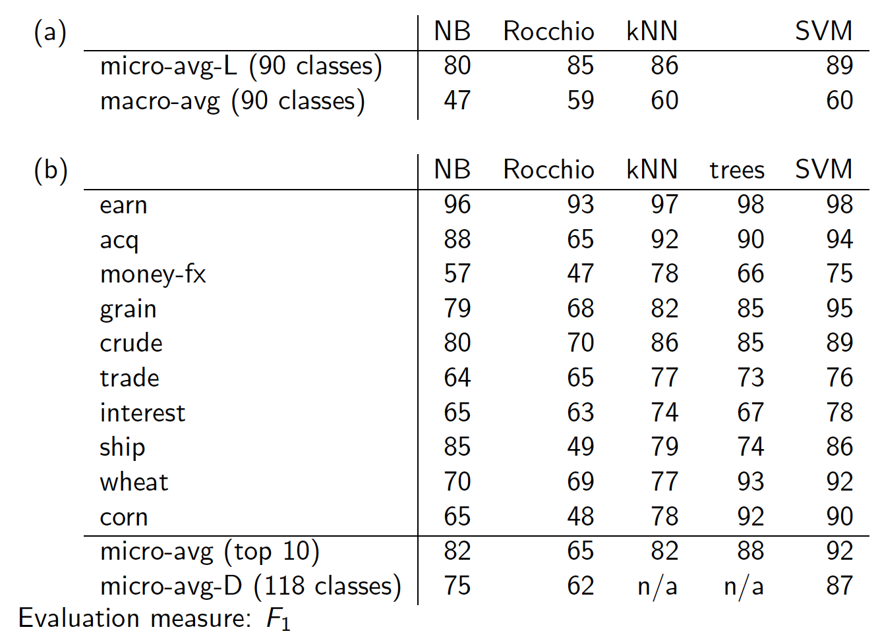
Evaluation

Slide 91
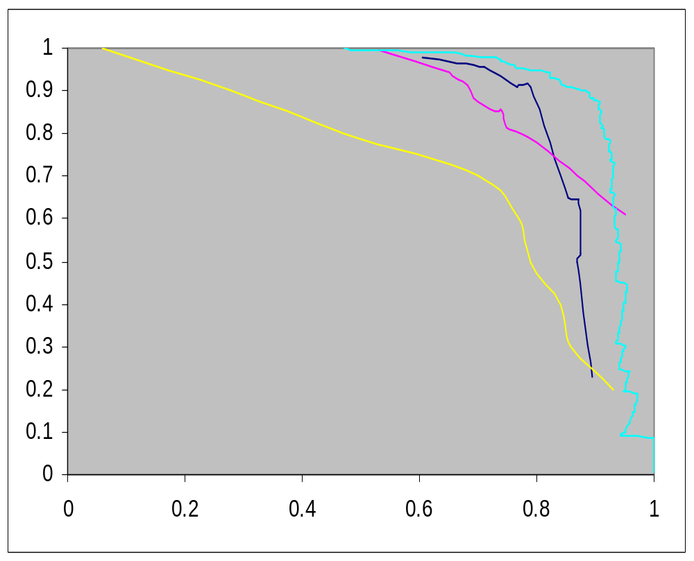
Precision-recall for category: Crude
Evaluation
Recall
LSVM
Decision Tree Naïve Bayes
Rocchio
Dumais (1998)
Precision

Slide 92
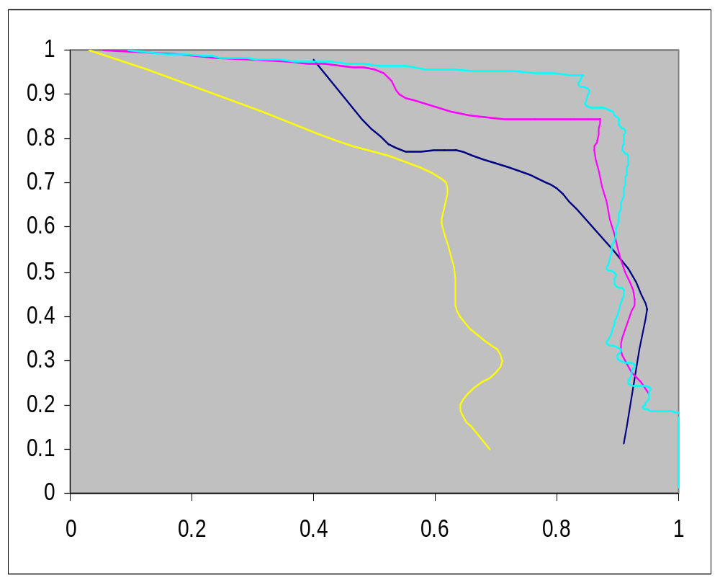
Precision-recall for category: Ship
Evaluation
Recall
LSVM
Decision Tree Naïve Bayes
Rocchio
Dumais (1998)
Precision

Slide 93
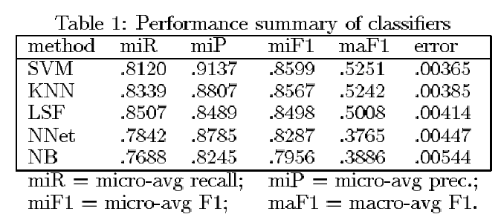
Yang&Liu: SVM vs. Other Methods
Evaluation

Slide 94
Resources
IIR 13-15
Fabrizio Sebastiani. Machine Learning in Automated Text Categorization. ACM Computing Surveys, 34(1):1-47, 2002.
Yiming Yang & Xin Liu, A re-examination of text categorization methods. Proceedings of SIGIR, 1999.
Trevor Hastie, Robert Tibshirani and Jerome Friedman, Elements of Statistical Learning: Data Mining, Inference and Prediction. Springer-Verlag, New York.
Open Calais: Automatic Semantic Tagging
  Free (but they can keep your data), provided by Thompson/Reuters
Weka: A data mining software package that includes an implementation of many ML algorithms

